Slide 1
Lab1: Introduction
ECE 0202

Slide 2


Who are we?
Luke Karavolis
CoE graduate
ljk55@pitt.edu
Wednesday 6 – 8PM
Mike Hayden
Junior CoE
msh81@pitt.edu
Thursday 6-8 PM

Slide 3
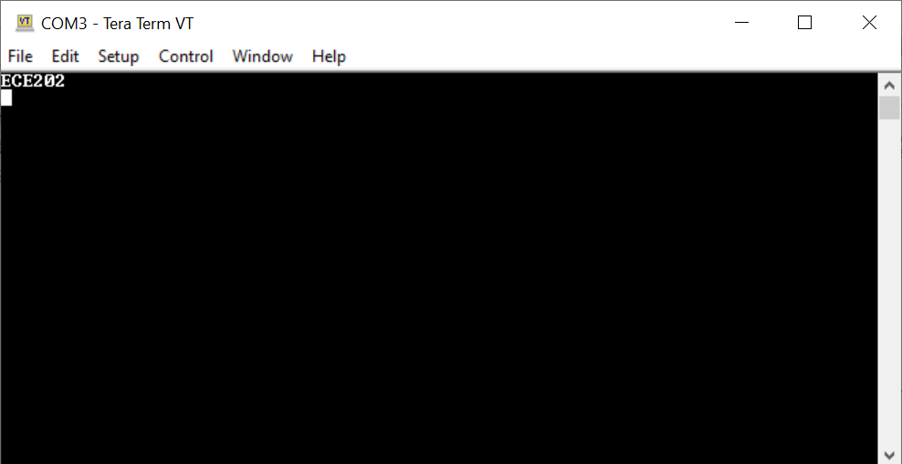
Objectives
Download and modify example code to run on your board
Install Keil
Download Device Driver
Create new project and update settings
Change the “main.s” code to display your last name

Slide 4
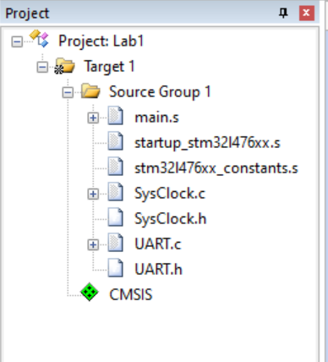
Keil Interface
Debugging Tools
Compile code
Target Settings
Flash to board
Everything beneath the target uses same settings
A group stores a collection of related files
.s files are assembly; .c and .h are c files

Slide 5
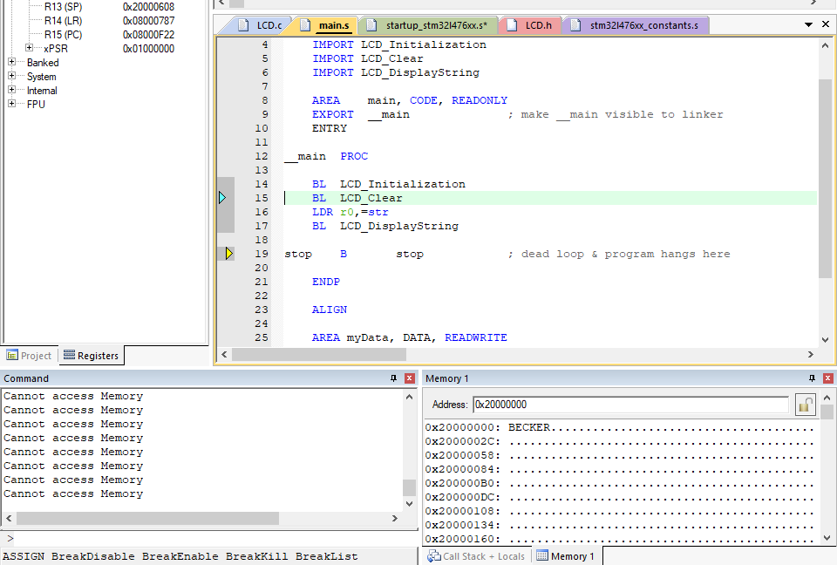

Submission
Start debug mode (with board plugged in)
2. Run code here
3. Memory: 0x20000000
Right click, view ascii
4. Screenshot!

Slide 6
General Tips
DO NOT PLUG IN THE BOARD IMMEDIATELY
“STM32 ST-LINK Utility” is a helpful program to test device connection and reset the board if things go wrong
Remember to push the reset button on the board after downloading code

Slide 7
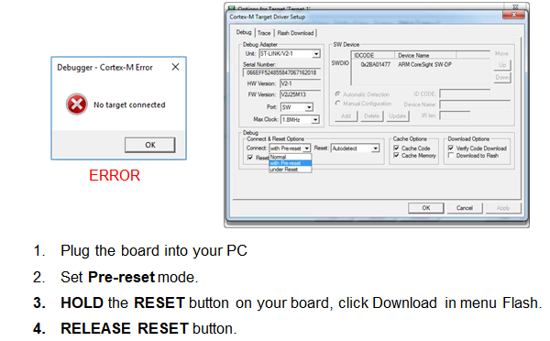
Common Issue: Target Not Found

